Slide 1
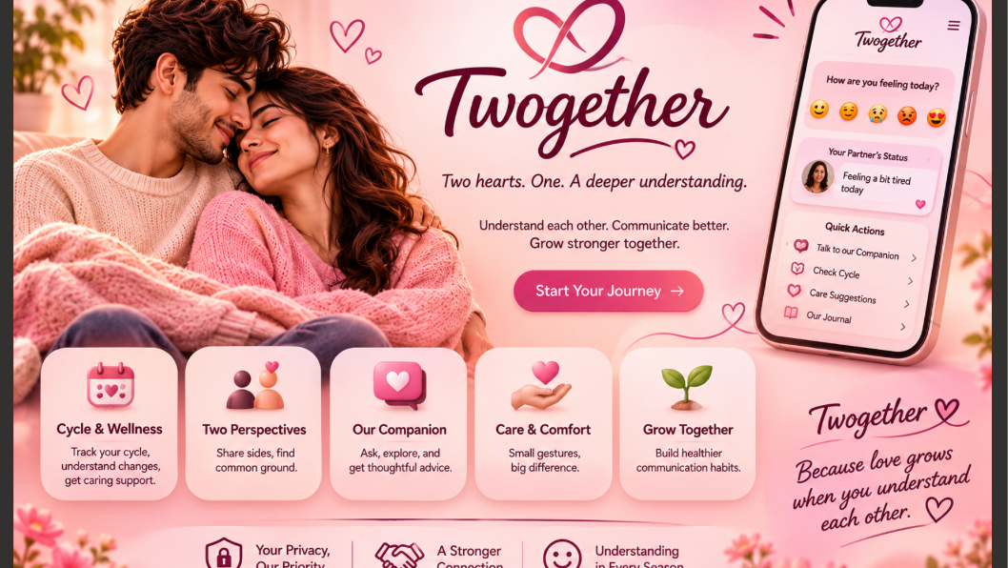
Twogether AI
Less Guessing. More Care.

Slide 2
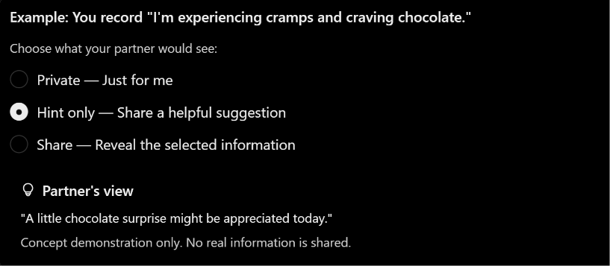
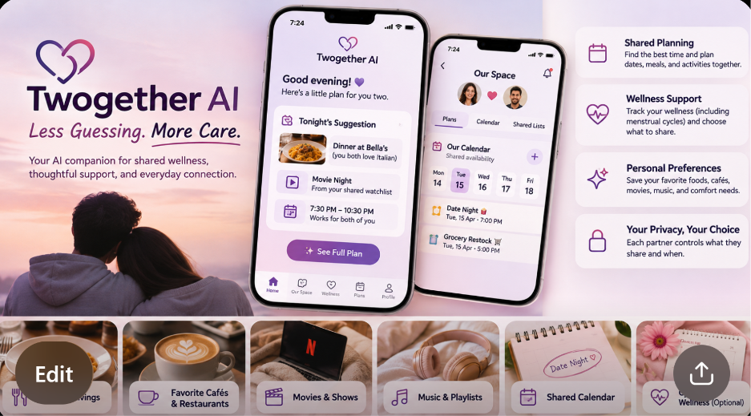
TWOGETHER AI / LESS GUESSING. MORE CARE.
01 Our agent: Twogether AI
A privacy-first lifestyle and shared wellness support agent for couples.
TWO + TOGETHER
Two individuals, one more thoughtful connection.
Our promise
Help partners understand each other’s preferences, express needs, and turn care into action—without giving up personal privacy.
02

Slide 3
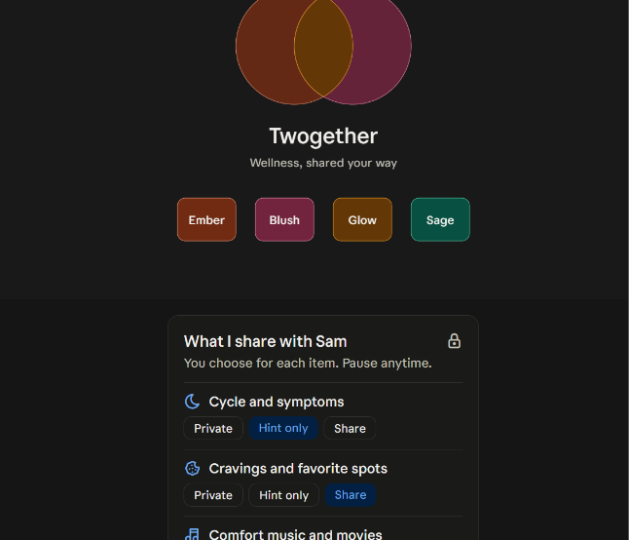
TWOGETHER AI / LESS GUESSING. MORE CARE.
Privacy is the product—not an afterthought
Both partners decide what to share, with whom, and for how long.
Private
Cycle details, symptoms, and personal notes stay private by default.
Hint only
Share a practical need without revealing its sensitive context.
Share
Explicitly approve specific preferences or information; revoke later.
09

Slide 4
TWOGETHER AI / LESS GUESSING. MORE CARE.
02 The problem we solve
Caring about someone does not always mean knowing what they need.
Communication gaps
Scattered preferences
Good intentions, little follow-through
Partners may not know when someone wants comfort, space, help, or a favorite treat.
Food, cafés, music, calendars, and wellness details live across different apps.
Planning dates, chores, and supportive gestures takes time and coordination.
Our opportunity: turn understanding into coordinated, consent-based action.
03

Slide 5
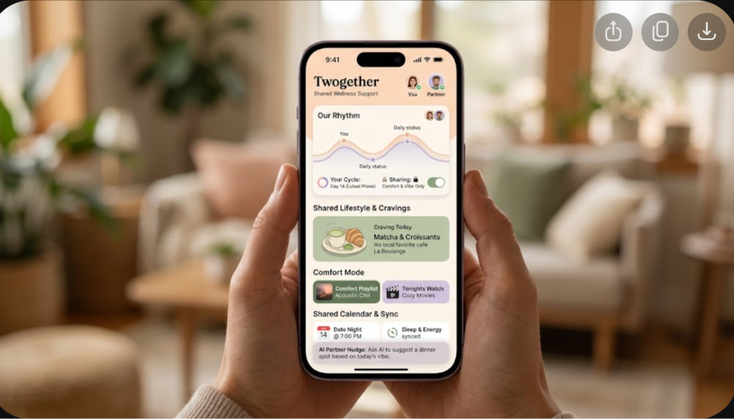
TWOGETHER AI / LESS GUESSING. MORE CARE.
03 Who uses Twogether?
Built for couples of any gender, with equal privacy controls for both partners.
Busy couples
Coordinate work, household responsibilities, and quality time.
Long-distance couples
Stay connected through shared experiences and thoughtful planning.
Different support needs
Share comfort preferences and optional wellness information on your terms.
04

Slide 6
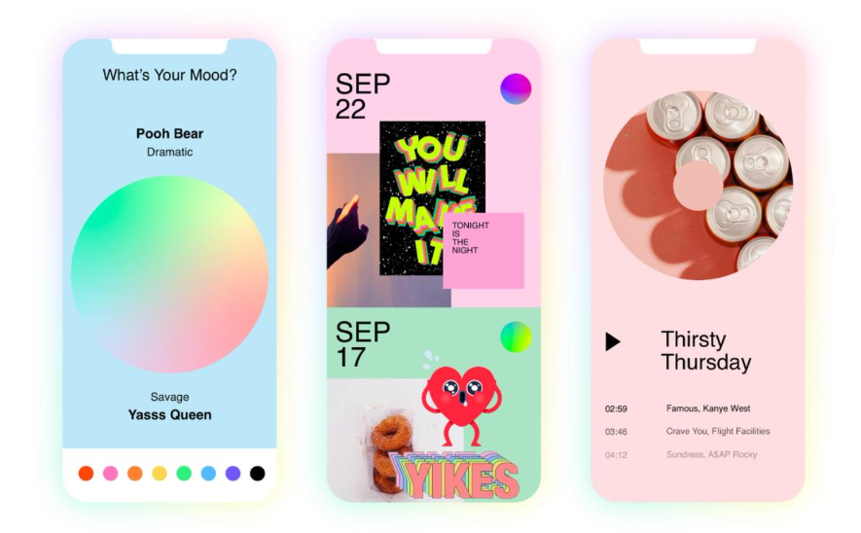
TWOGETHER AI / LESS GUESSING. MORE CARE.
The product experience
My Space + Our Space + Smart Actions
My Space
Private favorites, cravings and wellness.
Our Space
Approved sharing and shared calendars.
Smart Actions
Plans, reminders and task follow-through.
06

Slide 7
TWOGETHER AI / LESS GUESSING. MORE CARE.
04 Five tasks the agent can do
Autonomous planning and monitoring, with approval for consequential actions.
01 Date planning
02 Calendar coordination
03 Favorites & cravings
Research restaurants, cafés, movies and activities from approved preferences.
Find shared free time and propose schedules.
Organize food, playlists, comfort movies and saved places.
04 Wellness preparation
05 Shared task follow-up
Create private reminders and optional menstrual-cycle preparation lists.
Track agreed chores, send reminders and monitor completion.
05

Slide 8
TWOGETHER AI / LESS GUESSING. MORE CARE.
06 Tools and integrations
Start with a manageable MVP; expand as permissions and APIs allow.
Calendars
Places & booking
Entertainment
Google Calendar / Outlook
Maps, restaurants, reservation partners
Spotify and permitted watchlist integrations
Wellness
Communication
Secure infrastructure
Manual cycle logs; optional wearable data
Push notifications, approved messages
Encrypted storage, AI planner, permission engine
07

Slide 9
TWOGETHER AI / LESS GUESSING. MORE CARE.
07 From a goal to a completed plan
Example: “Plan a relaxing Friday night for both of us.”
1. Understand
2. Retrieve
3. Research
Goal, budget and constraints
Approved favorites and free/busy times
Restaurants, movies and options
4. Plan
5. Approve
6. Execute
Best-fit dinner and activity
Ask before booking or sharing
Create reminders; monitor changes
08

Slide 10
TWOGETHER AI / LESS GUESSING. MORE CARE.
09 Autonomous decisions vs. human approval
The agent should act independently only within clearly defined permissions.
CAN DO WITHOUT NEW APPROVAL
MUST ASK FIRST
• Rank activities using shared preferences
• Identify free calendar slots
• Organize private reminders
• Update explicitly entered favorites
• Follow up on already-authorized tasks
• Share health or cycle details
• Send a new sensitive message
• Purchase or book an experience
• Change shared commitments
• Connect accounts or expand access
10

Slide 11
TWOGETHER AI / LESS GUESSING. MORE CARE.
10 Real-life example: a thoughtful evening
A private preference becomes a shared experience—not a privacy leak.
User preference
“I’m craving pasta and want a quiet evening.”
Twogether plans
Checks approved favorites, shared availability and movie lists.
Result
Suggests Italian dinner + comfort movie; requests approval before booking. Private cycle data stays private.
11

Slide 12
TWOGETHER AI / LESS GUESSING. MORE CARE.
11 Business model & investment
Freemium pricing and a focused $100,000 MVP.
Free — $0
Plus — $5.99/mo
Couples — $9.99/mo
Basic favorites, lists and reminders.
Personalized planning and wellness features.
Shared coordination and advanced integrations.
Proposed investment allocation
App & AI
Privacy
Integrations
User testing
Launch
$45,000
$20,000
$15,000
$10,000
$10,000
Illustrative pricing and costs; market validation is still required.
12

Slide 13
TWOGETHER AI / LESS GUESSING. MORE CARE.
12 Why Twogether instead of a chatbot?
The advantage is the dedicated, privacy-aware workflow—not AI alone.
CAPABILITY
GENERAL CHATBOT
TWOGETHER AI
Personalization
One-off advice or general memory
Two user-controlled profiles
Planning
Suggests ideas
Coordinates approved preferences and calendars
Wellness
Explains topics
Optional private cycle logging and preparation
Follow-through
Often needs another prompt
Monitors agreed tasks and reminders
Privacy
General sharing settings
Explicit, two-way sharing per category
13

Slide 14
Twogether AI
Less Guessing. More Care.
We turn understanding into everyday care—on each person’s terms.

Slide 15
Group 1
Sakshi Vinod Manghnani
Kirubanandhan mani
Akshaya munirathinam
Lahir Vineeth karuturi
Haixu Song
Baavana Podugu

